Slide 1

Red Team / Blue Team
Capstone Project 2
Assessment, Analysis and Hardening of a Vulnerable System
Courtney Templeton
University of Richmond • Cybersecurity Boot Camp • November 14, 2021

Slide 2
Table of Contents
01
Network Topology
02
Red Team: Security Assessment
03
Blue Team: Log Analysis and Attack Characterization
Hardening: Blue Team Proposed Alarms and Mitigation Strategies
04

Slide 3



Network Topology

Slide 4
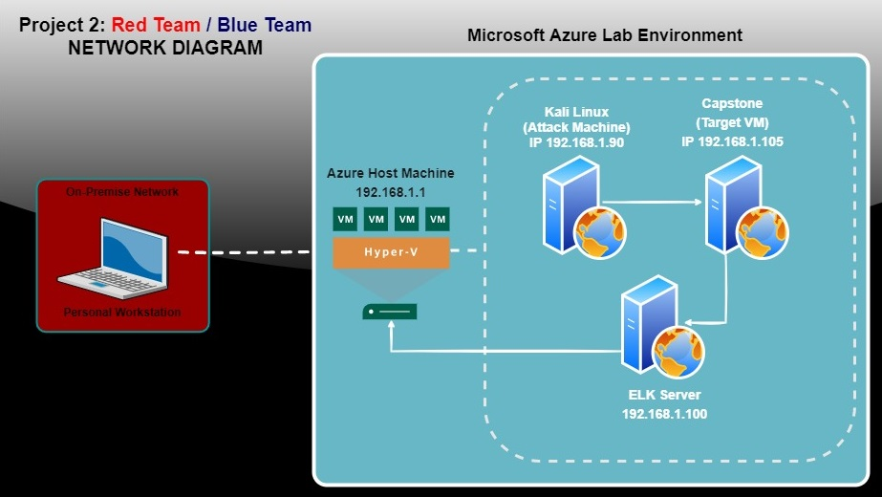
NETWORK TOPOLOGY

Slide 5

Red Team
Security Assessment
5

Slide 6
Recon: Describing the Target
Nmap identified the following hosts on the network:
Hostname | IP Address | Role on Network
Azure Host Machine | 192.168.1.1 | Azure Cloud-Based Hyper-V Host for the Attacker, Target, and ELK Stack VMs
Kali Linux (Attacker) | 192.168.1.90 | Attacking Machine
Capstone (Target) | 192.168.1.105 | Target Vulnerable Webserver
ELK Stack | 192.168.1.100 | Elasticstash/Logstash/Kibana Stack for capturing Packetbeat, Metricbeat and Filebeat Data

Slide 7
Vulnerability Assessment
The assessment uncovered the following critical vulnerabilities in the target:
Vulnerability | Description | Impact
Sensitive Data Exposure OWASP Top 10 #3 Critical | The secret_folder is publicly accessible, but contains sensitive data intended only for authorized personnel | The exposure compromises credentials that attackers can use to break into the web server
Unauthorized File Upload Critical | Users are allowed to upload arbitrary files to the web server | This vulnerability allows attackers to upload PHP scripts to the server
Remote Code Execution via Command Injection OWASP Top 10 #1 Critical | Attackers can use PHP scripts to execute arbitrary shell commands | Vulnerability allows attackers to open a reverse shell to the servers

Slide 8
Additional Vulnerabilities
Vulnerability | Description | Impact
Directory Indexing Vulnerability CWE-548 | Attacker can view and download content of a directory located on a vulnerable device. CWE-548 refers to an informational leak through directory listing. | The attacker can gain access to source code, or devise other exploits. The directory listing can compromise private or confidential data.
Hashed Passwords | If a password is not salted it can be cracked via online tools such as www.crackstation.net/ or programs such as hashcat | Once the password is cracked, and if a username is already known, a hacker can access system files
Weak Usernames and Passwords | Commonly used passwords such as simple words, and the lack of password complexity, such as the inclusion of symbols, numbers and capitals | System access could be discovered by social engineering. https://thycotic.com/resources/password-strength-checker/ suggests that ‘Leopoldo’ could be cracked in 21 seconds by a computer.

Slide 9
Additional Vulnerabilities
Additional Vulnerabilities
Vulnerability | Description | Impact
Port 80 Open with Public Access CVE-2019-6579 | Open and unsecured access to anyone attempting entry using Port 80 | Files and Folders are readily accessible. Sensitive (and secret) files and folders can be found.
Brute Force Ability to discover passwords by Brute Force CVE-2019-3746 | When an attacker uses numerous username and password combinations to access a device and/or system. | Easy system access by use of brute force with common password lists such as rockyou.txt by programs such as Hydra
HTTP & WebDAV Plaintext protocols (HTTP and WebDAV) | Without the use of secure protocols information of all kinds is unsecured and vulnerable to interception | Using plain text protocols like HTTP and WebDAV presents opportunities for sensitive data exposure, traffic redirection, malware installation, corruption of critical information, and installation of client-side code

Slide 10
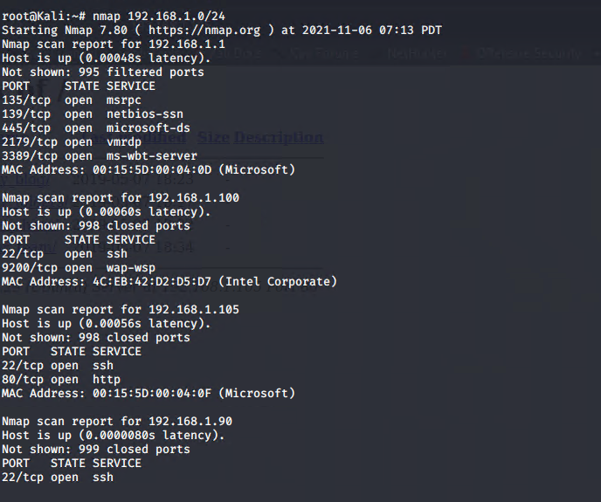
Exploitation: Sensitive Data Exposure - Tools and Processes
01
Tools & Processes
nmap to scan network
dirb to map URLs
Browser to explore

Slide 11
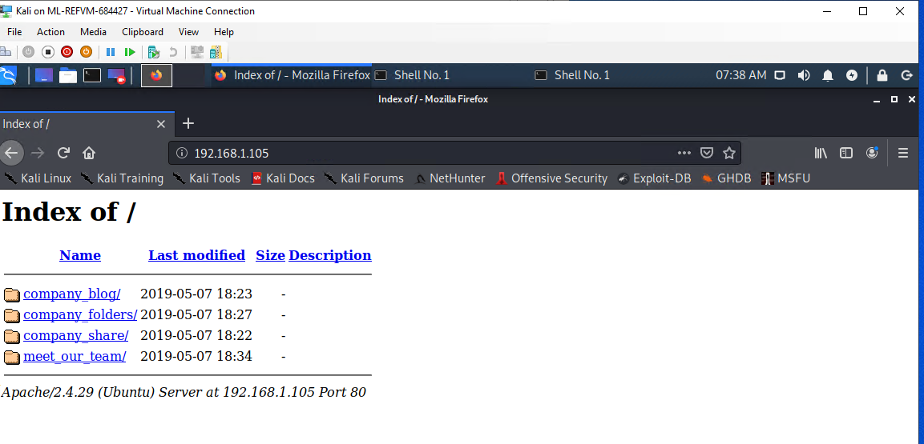
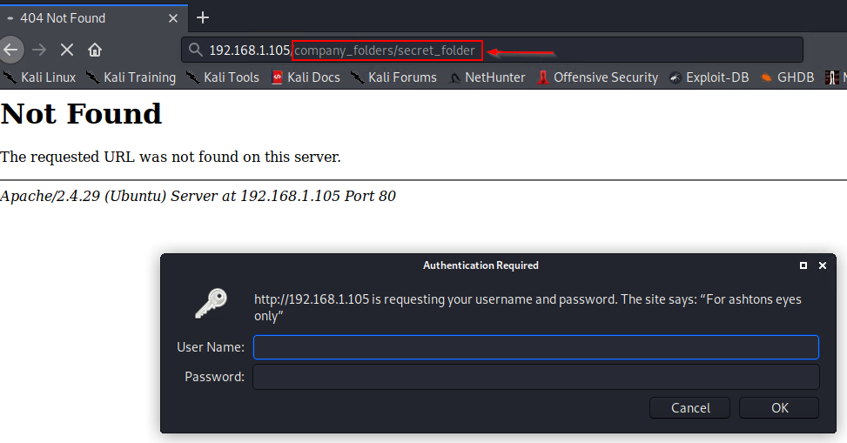
Exploitation: Sensitive Data Exposure - Achievements
02
Achievements
The exploit revealed a secret_folder directory.
This directory is password protected, but susceptible to brute-force.
←
“company_folders” reveals a “secret_folder”

Slide 12
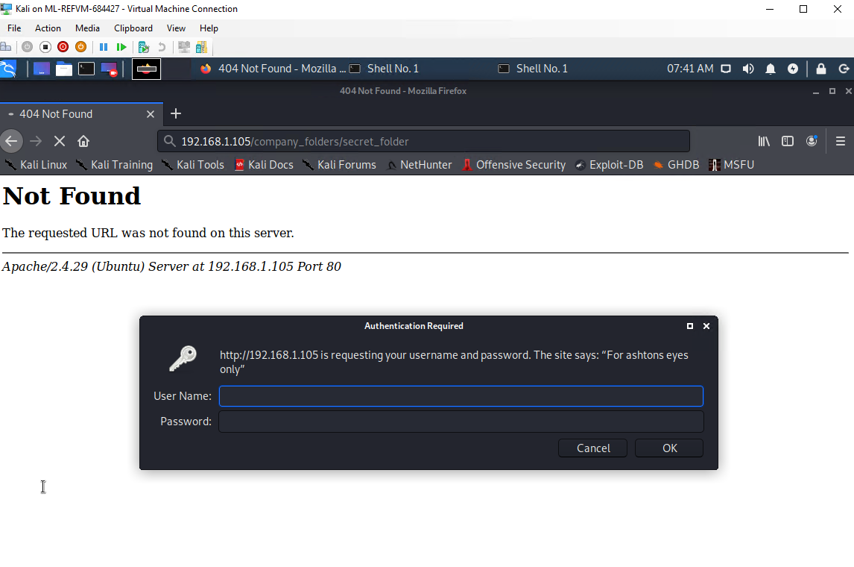
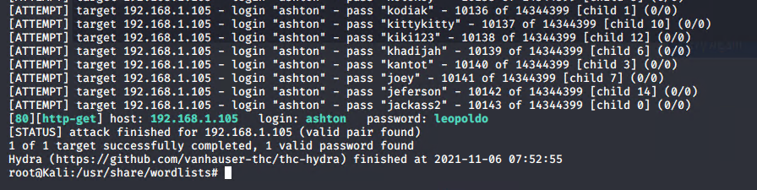
Exploitation: Sensitive Data Exposure - Login Prompt
03
Exploitation – Login Prompt
The login prompt reveals that the user is ashton.
This information is used to run a brute-force attack and gain access to the secret_folder

Slide 13
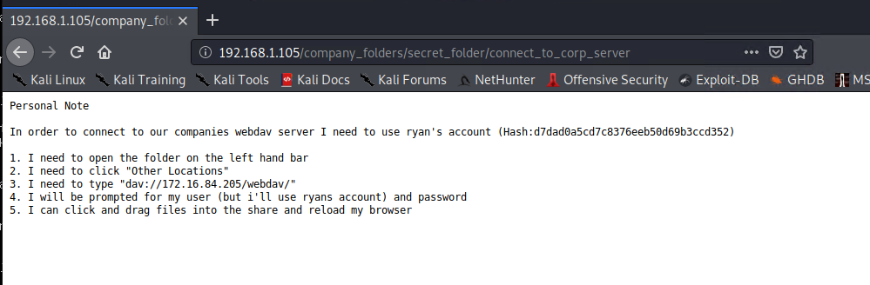
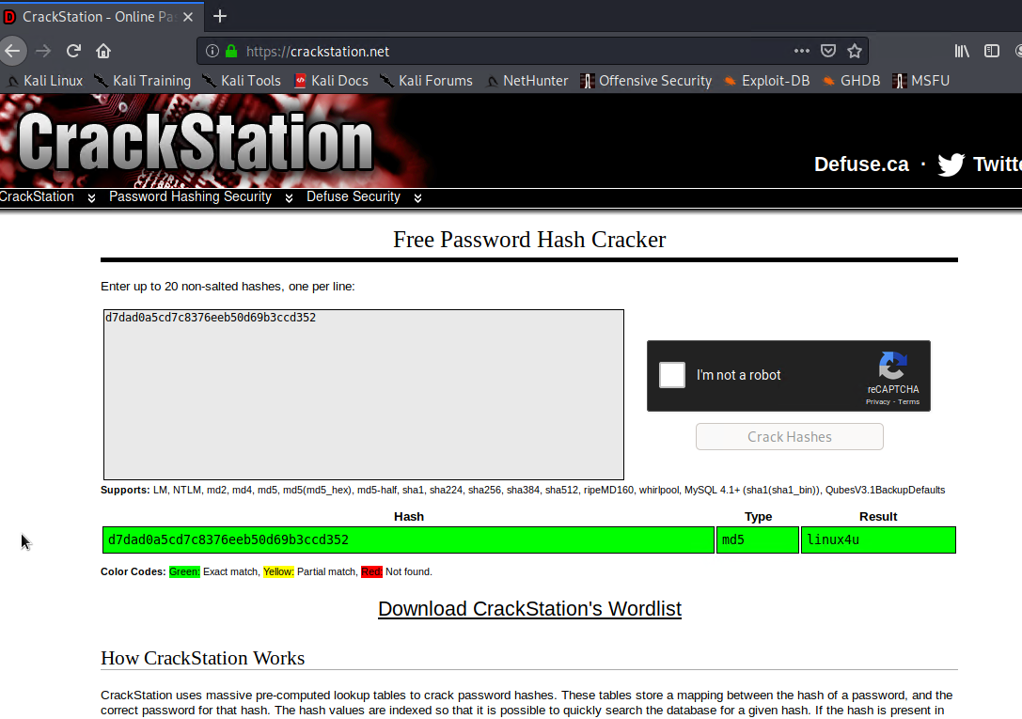
Exploitation: Unauthorized File Upload – Tools & Processes
01
Use rockyou.txt password list to crack “ashton” user password
Tools & Processes
Access gained to user ashton after using rocyou.txt password list to crack it.
Sensetive data on how to proceed using user ryan revealed
CrackStation was used to crack the hash for user ryan’s password and gain full access to WebDAV and secret_folder
Message after accessing “ashton”
Crack hash for user “ryan” password

Slide 14
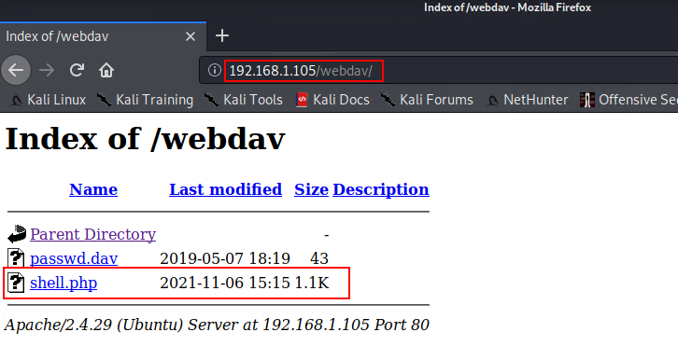
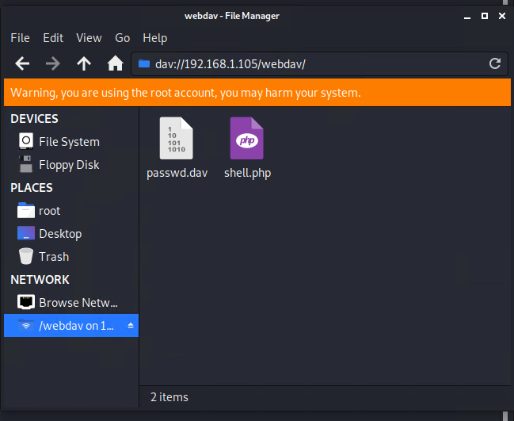
Exploitation: Unauthorized File Upload – Tools & Processes
02
Tools & Processes
Full access to WebDAV and secret_folder gained
Shell uploaded to WebDAV

Slide 15
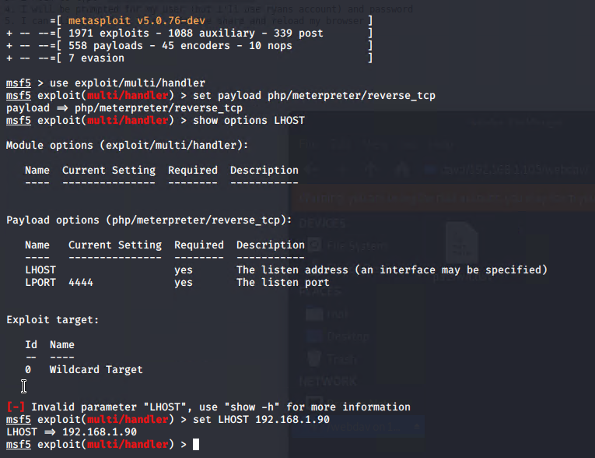
Exploitation: Unauthorized File Upload – Achievements & Aftermath
03
Achievements
Generate custom web shell with msfconsole
Uploading the reverse web shell allows us to execute arbitrary shell commands on the target
Aftermath
Running arbitrary shell commands allows Meterpreter to open a full-fledged connection to the target

Slide 16
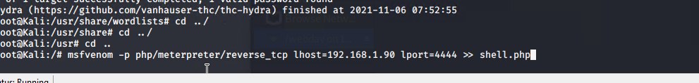
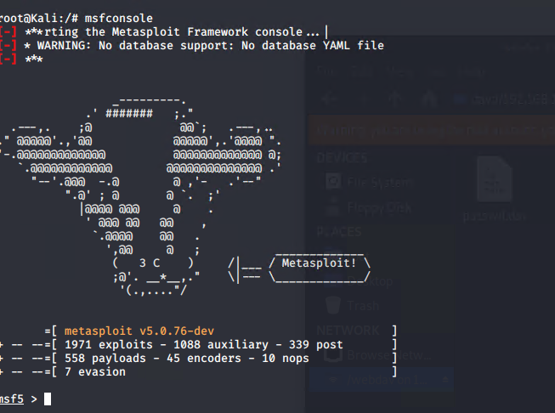
Exploitation: Remote Code EXECUTION – Tools and Processes
01
Tools & Processes
Use Meterpreter to connect to uploaded web shell
Use shell to explore and compromise target

Slide 17
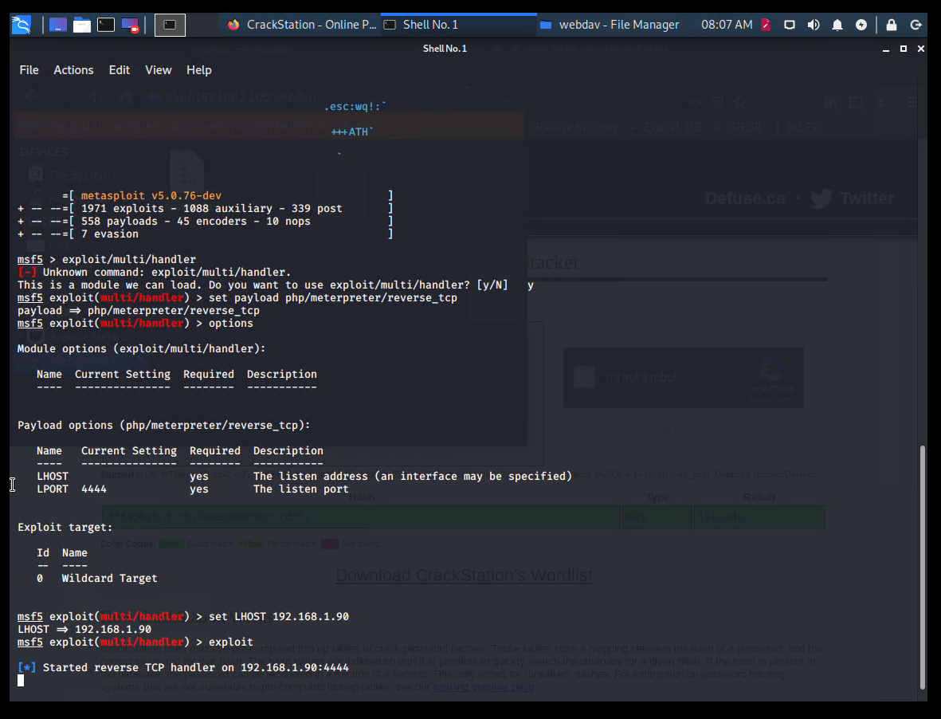
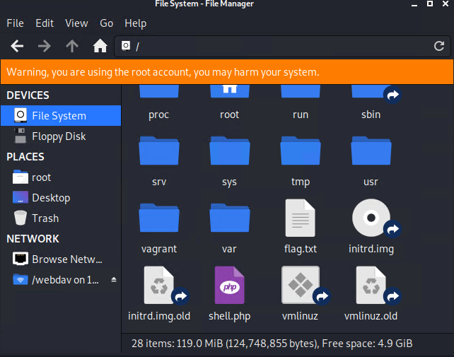
Exploitation: Remote Code EXECUTION – AChievemenets
02
Achievements
Leveraging the Remote Code Execution (RCE) allows us to open a Meterpreter shell to the target
Once on the target, the full file system is available for exploration

Slide 18
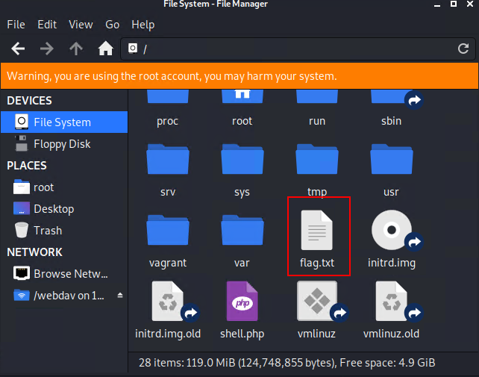
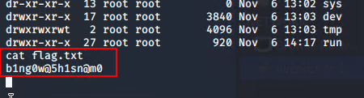
Exploitation: Remote Code Execution - Aftermath
03
Aftermath
Achieving a shell on the target allows us to display all files and capture the flag

Slide 19


Blue Team
Log Analysis and Attack Characterization
19

Slide 20
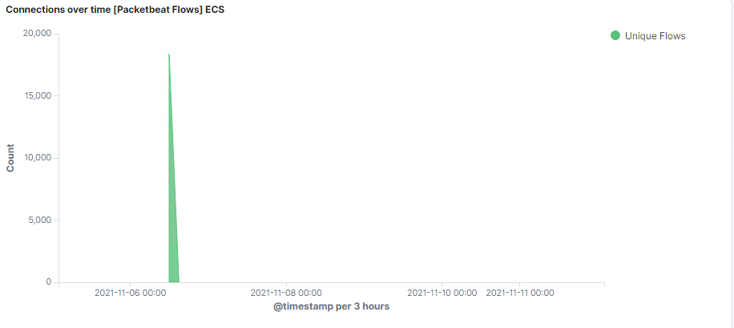
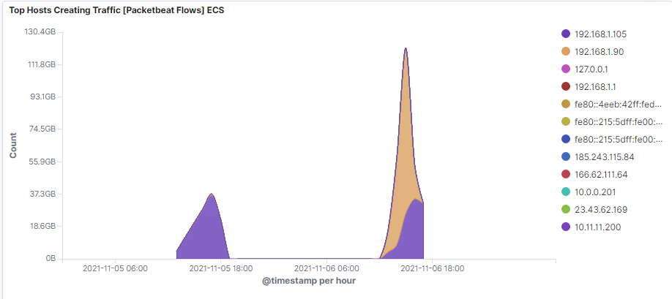
Analysis: Identifying the Port Scan
The screenshots below indicate that the port scan occurred between 12:00 and 18:00 (12pm – 6pm), with approximately 18,000 packets being sent from IP address 192.168.1.90

Slide 21
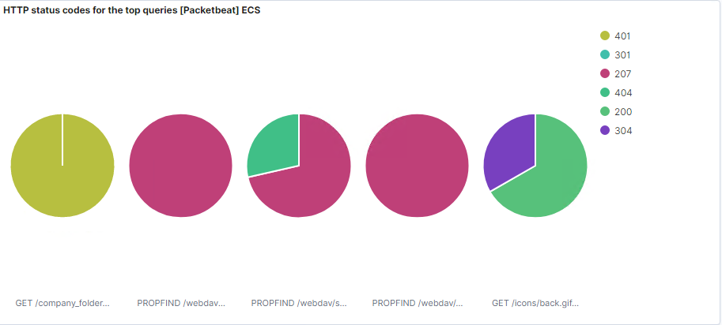
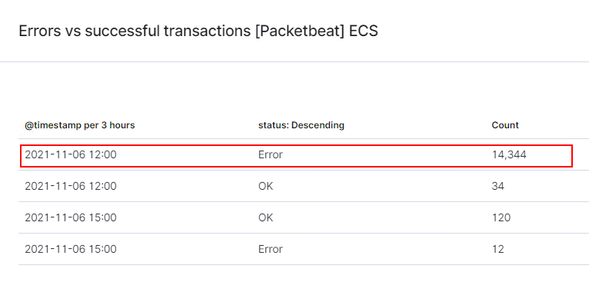
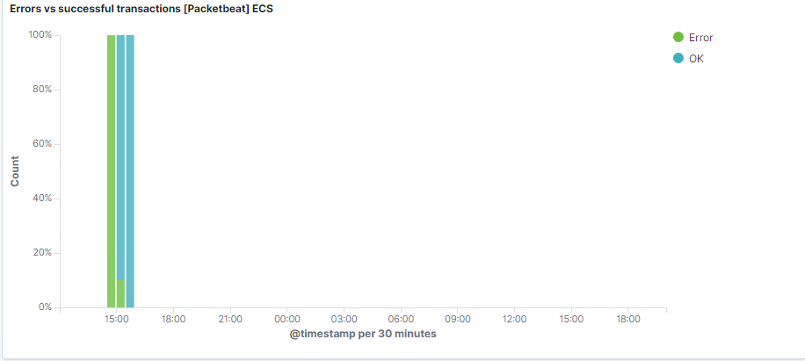
Analysis: Identifying the Port Scan
The victim responded back with the following codes:
401 (UNAUTHORIZED)
301 (MOVED PERMANENTLY)
207 (MULTI-STATUS)
404 (CLIENT ERROR)
200 (SUCCESS/OK)
304 (RESOURCE NOT MODIFIED)
After the port scan occurs, continual “ERROR” responses transition over to “OK” between 14:00 – 15:00 (2 – 3pm)

Slide 22
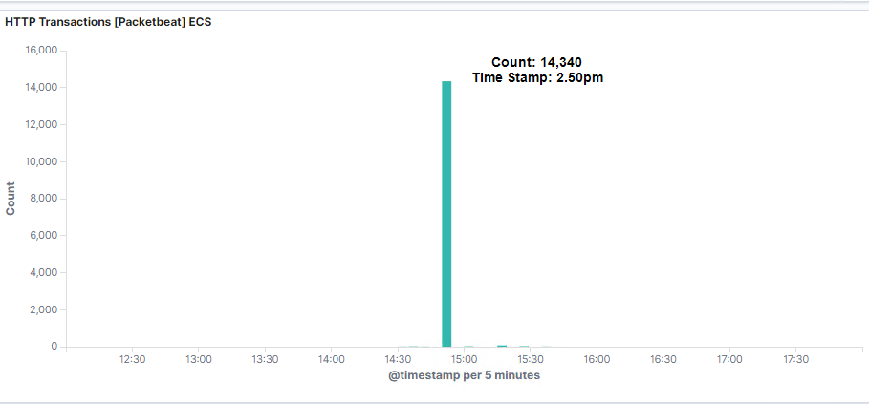
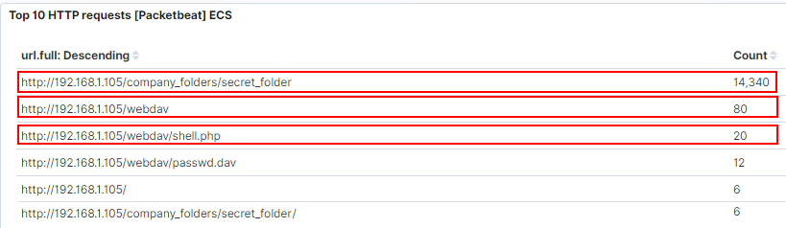
Analysis: Finding the Request for the Hidden Directory
What time did the request occur? How many requests were made?
In the above image we can observe that the attack started around 2:50pm with 14,340 HTTP transactions.
Which files were requested?
The top three hits for directories and files that were requested included the shell.php file . They were:
http://192.168.1.105/company_folder/secret_folder
http://192.168.1.105/company_folder/webdav
http://192.168.1.105/webdav/shell.php

Slide 23
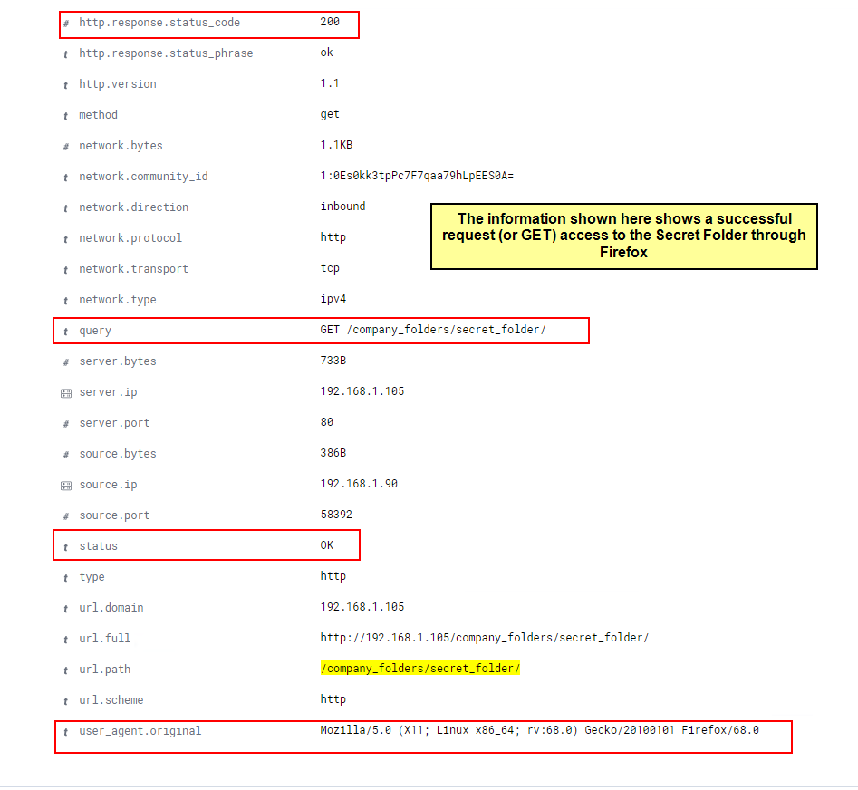
Analysis: Finding the Request for the Hidden Directory
Here we can see proof of a successful login from the suspicious source IP 192.168.1.90 to the secret folder from within Firefox

Slide 24
Analysis: Finding the WebDAV Connection
The secret_folder directory was requested 14,340 times.
The shell.php file was requested 20 times.

Slide 25
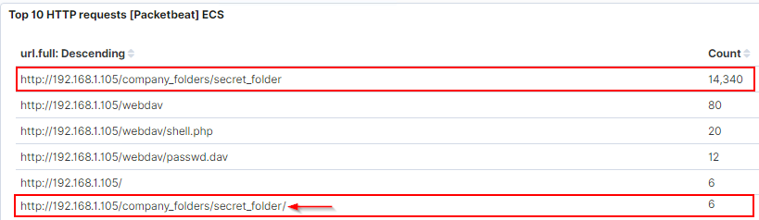
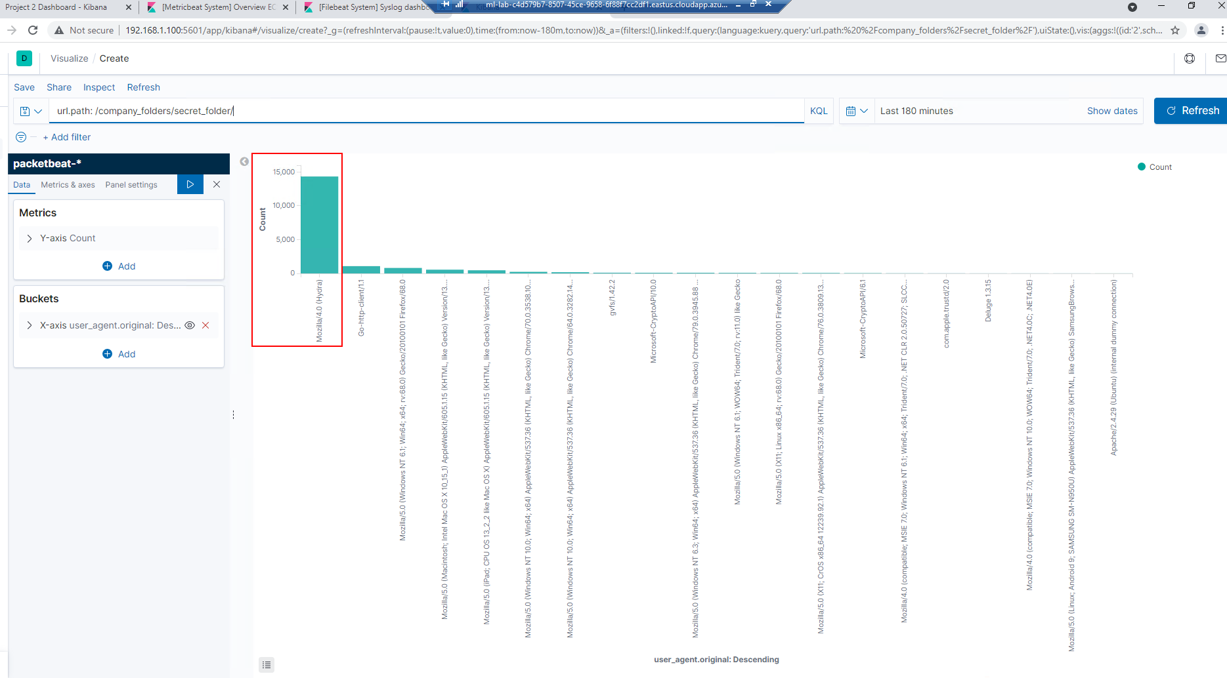
ANALYSIS:
UNCOVERING THE BRUTE FORCE ATTACK
Below we see the secret_folder had unsuccessful attempted access 14,340 times. However, successful access was eventually gained 6 times (as seen by the added slash at the end of the directory in this list of URLs requested indicating access was successful)
This image shows a high volume of Mozilla Hydra attempts on the sensetive, password protected “secret_folder.” This tool is often used for Brute Force attempts and is one indicator of the attack.

Slide 26
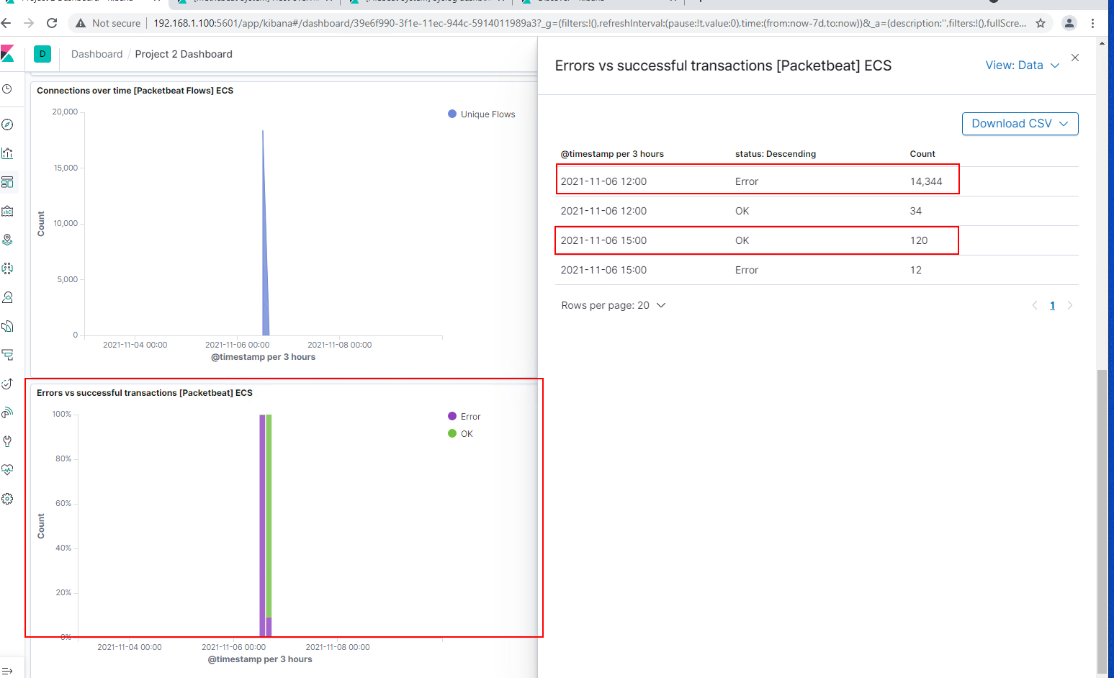
ANALYSIS: UNCOVERING THE BRUTE FORCE ATTACK
These logs contain evidence of a large number of requests for the sensitive data. 14, 344 attempts were “errors” (or failed logins) at 12:00 (12pm) while further down, by 15:00 (3pm), 120 transactions were “ok”.
Notes:
Note: The image on the right hand side is an example of hydra failing to access the contents of the secret_folder directory.

Slide 27

Blue Team
Proposed Alarms and Mitigation Strategies
27

Slide 28




Mitigation: Blocking the Port Scan
ALARM
SYSTEM HARDENING
What kind of alarm can be set to detect future port scans?
Set threshold for number of requests per second
What threshold would you set to activate this alarm?
Alarms should fire if a given IP address sends more than 10 requests per second for more than 5 seconds
What configurations can be set on the host to mitigate port scans?
The local firewall can be used to throttle incoming connections
ICMP traffic can be filtered
An IP allowed list (or “Whitelist”) can be enabled
Regularly run port scans to detect and audit any open ports
Regularly patch the Firewall to minimize vulnerabilities

Slide 29

Mitigation: Finding the Request for the Hidden Directory
ALARM
SYSTEM HARDENING
What kind of alarm can be set to detect future unauthorized access?
Allow only authorized IP addresses
Trip an alarm if an IP not on the allowed list attempts to connect
What threshold would you set to activate the alarm?
This is a binary alarm: the alarm will only be triggered if the incoming IP is not allowed. Otherwise it does not.
What configuration can be set on the host to block unwanted access?
Access to the sensitive file can be locally restricted to a specific user
Confidential files and folders should be prohibited from being shared publicly at all
This way, someone who gets a shell, e.g., www-data will not be able to read it
In addition, the file should be encrypted at rest

Slide 30

Mitigation: Preventing Brute Force Attacks
ALARM
SYSTEM HARDENING
What kind of alarm can be set to detect future brute force attacks?
Number of Requests per Second
What threshold would you set to activate the alarm?
Alarms should be set for any given IP address that sends more than 10 requests per second for more than 5 seconds
What configuration can be set on the host to block brute force attacks?
Configure fail2ban or similar utility to scan log files and ban IPs that show malicious signs
Lockout an account after 10 failed login attempts
Force the use of Multi-factor Authentication (MFA)
Use the local firewall to throttle incoming connections
Whitelist trusted IPs

Slide 31


Mitigation: Detecting the WebDAV Connection
ALARM
SYSTEM HARDENING
What configuration can be set on the host to control access?
Administrators must install and configure Filebeat on the host
Create a Whitelist of trusted IP addresses
Perform User access reviews every 6 months to maintain the Principle of Least Privilege
What kind of alarm can be set to detect future access to this directory?
Monitor access to WebDAV with Filebeat
Fire an alarm on any read performed on files within WebDAV
What threshold would you set to activate this alarm?
Fire the alarm whenever someone accesses the WebDAV directory
Allow valid IP addresses

Slide 32


Mitigation: Identifying Reverse Shell Uploads
ALARM
SYSTEM HARDENING
What kind of alarm can be set to detect future file uploads and what threshold would you set to atctivate it?
Alarms should fire upon receipt of any POST request containing form or file data of a disallowed file type, e.g. “.php”
The alarm should fire whenever users upload a forbidden file
What configuration can be set up on the Host to block file uploads?
Write permissions cab be restricted on the host
Uploads can be isolated into a dedicated storage partition
Filebeat should be enabled and configured
What configuration can be set on the host to block file uploads?
Write permissions can be restricted on the host
Uploads can be isolated into a dedicated storage partition
Filebeat should be enabled and configured

Slide 33

The End

